Slide 1
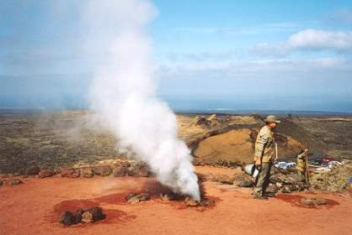
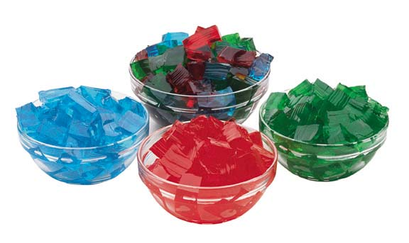
Bellwork Tuesday
List three differences in the particles that make up the substances below.

Slide 2
CHEMISTRY CHAPTERs 13 and 14 THE STATES OF MATTER and gas laws Part 1

Slide 3
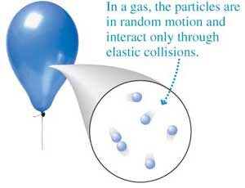
Kinetic theory of gases- valid only at extremely low density
1. A gas is composed of particles, usually molecules or atoms. We treat them as…
Hard spheres
Insignificant volume
Far from each other

Slide 4
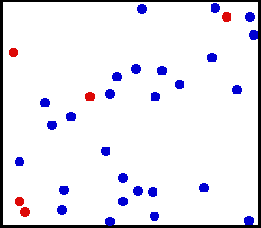
2.The particles in a gas move rapidly in constant random motion.
3.All collisions are perfectly elastic- no Energy lost
The average speed of an O₂ molecule is 1656 km/hr!!!

Slide 5
Kinetic energy (KE)- the energy an object has because of its motion When a gas is heated, it absorbs thermal energy. Some of this energy is converted to KE to increase the motion of particles.

Slide 6
*The average KE of a gas is proportional to the Kelvin temperature. *Particles at 200K have twice the KE of particles at 100K. *The Kelvin temp scale is used because 0K (absolute zero) is the temp at which all motion ceases.

Slide 7
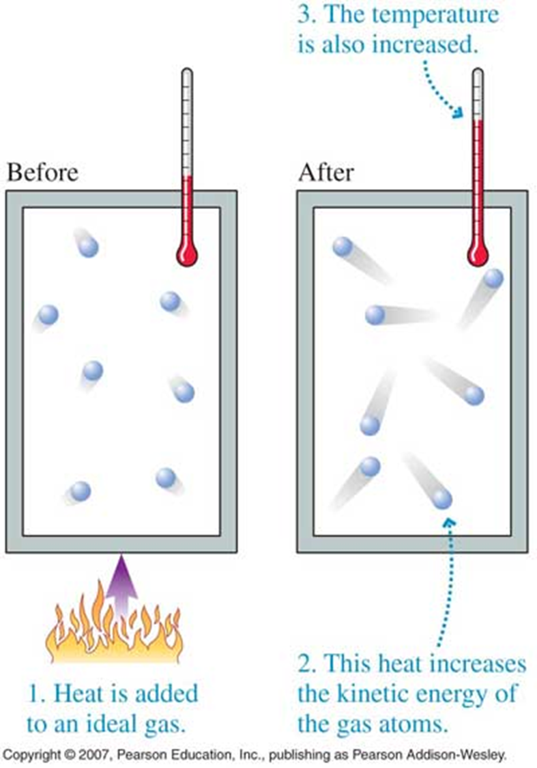

Slide 8
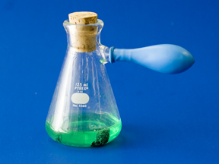
Gas Pressure- the result of the collisions of gas particles with an object
Where are the pressurized areas in this picture?

Slide 9
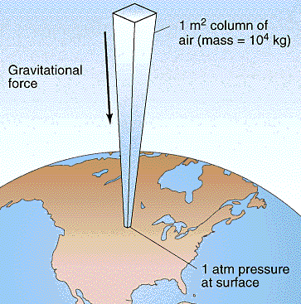
Atmospheric pressure-
The pressure caused by the weight of the atmosphere.
It decreases with an increase in elevation because the atmospheric gases are less dense

Slide 10
Are atmospheric pressures higher or lower in the mountains? Why?
The pressure is lower in the mountains because there are fewer air particles pressing down on you. This means that there are fewer particle collisions. Higher elevation→ less gas particles→less collisions→lower pressure

Slide 11
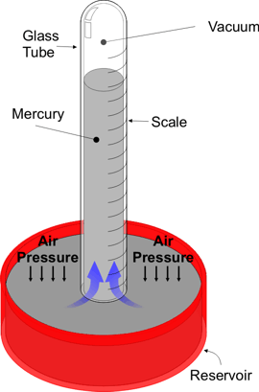
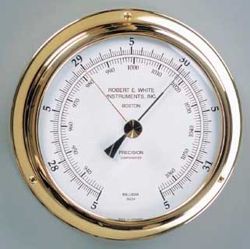
Barometer- instrument used to measure atmospheric pressure

Slide 12
SI unit of pressure- pascal (Pa) Standard atmospheric pressure = 101.3 kilopascals (kPa) 1 mm Hg = pressure needed to support a column of mercury 1 mm high Stp = 1 atm of pressure and o°C (273 K) 1 atm = 760 mm Hg = 760 torr =101.3 kPa
YOU MUST KNOW
THESE MEASUREMENTS!

Slide 13
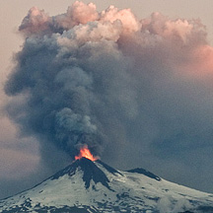
CHAPTER 14.1 THE BEHAVIOR OF GASES

Slide 14
KMT: a summary
States that:
Gases are composed of particles that are considered to be hard spheres with little volume.
These particles are spaced far apart from one another and are in constant motion.
They collide in a perfectly elastic manner so that energy is never lost.

Slide 15
Variables That Describe a Gas
Compressibility – a measure of how much the volume of matter decreases under pressure.
P = pressure
V = volume
T = temperature
n = number of moles

Slide 16
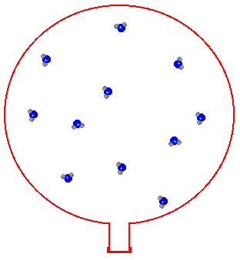
What Happens when you add or remove gas from a system?
Adding gas to a container(system)
Increases the number of particles
Increases the number of collisions
And thus increases the pressure in the container
Removing gas from a container
Decreases the number of particles
Decreases the number of collisions
And thus decreases the pressure

Slide 17
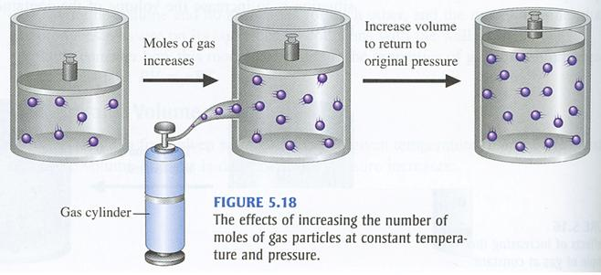
Pressure and Particles are related
The number of particles of gas and pressure are directly related. double # of particles = double pressure x 2
Airing up a balloon illustrates this!

Slide 18
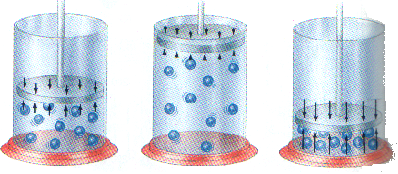
The Effect Of Changing The Size Of The Container Increase Volume → Decrease Pressure Decrease Volume → Increase Pressure
Volume and Pressure are indirectly related. If you cut the volume in half, the pressure doubles.

Slide 19
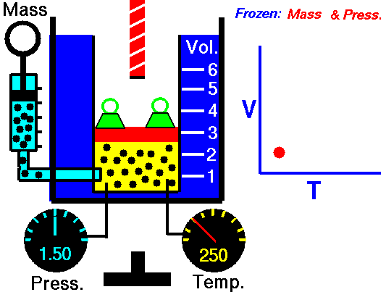
The Effect of Heating or Cooling a Gas Compressing A Gas Increases Its Temperature. Expanding A Gas Decreases Its Temperature.
Heating a Gas
Increases KE
Increases the number of collisions with the walls of the container
Thus increasing the pressure
Cooling a Gas
Decreases KE
Decreases the number of collisions with the walls of the container
Thus decreasing the pressure

