Slide 1
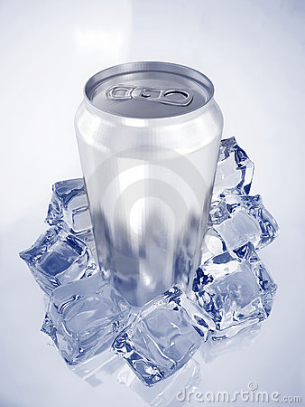
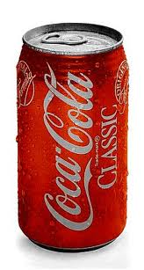
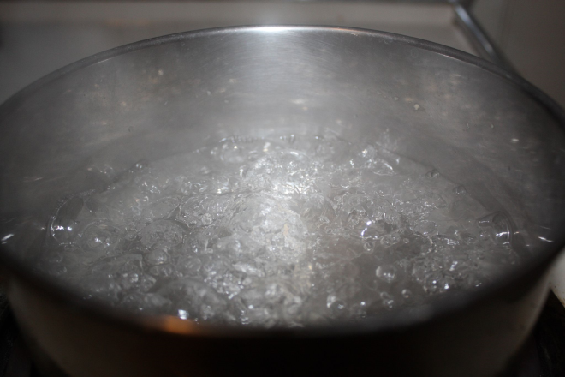
Bellwork
Three soda cans are placed into three different situations as shown below. Which soda can has particles with the highest kinetic energy and why? What does this do to the pressure inside the can?

Slide 2
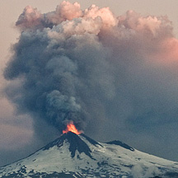
CHEMISTRY CHAPTER 12 THE BEHAVIOR OF GASES

Slide 3
KMT Revisited
States that:
Gases are composed of particles that are considered to be hard spheres with little volume.
These particles are spaced far apart from one another and are in constant motion.
They collide in a perfectly elastic manner so that energy is never lost.

Slide 4
Variables That Describe a Gas
Compressibility – a measure of how much the volume of matter decreases under pressure.
P = __pressure_______
V = __volume_______
T = __temperature____
n = _number of moles_

Slide 5
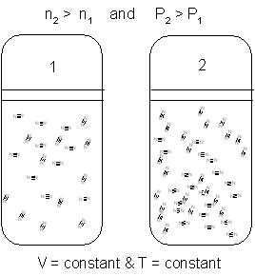
The Effect of Adding or Removing Gas adding gas → increases # of particles → increases # of collisions → increases pressure removing gas → decreases # of particles → decreases # of collisions → decreases pressure

Slide 6
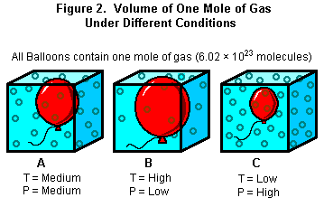
The number of particles of gas and pressure are directly related. double # of particles = double pressure

Slide 7
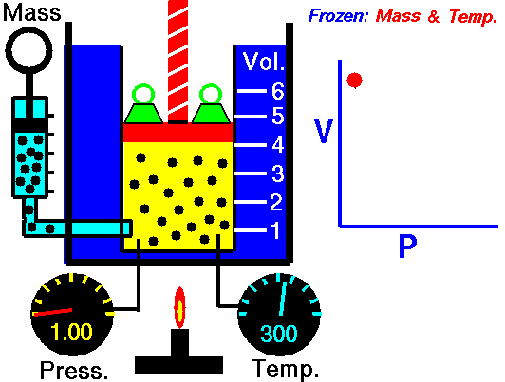
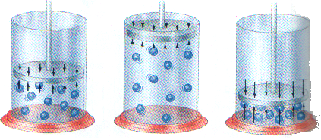
The Effect of Changing the Size of the Container increase volume → decrease pressure decrease volume → increase pressure
Volume and Pressure are indirectly related. cut volume in half = pressure doubles

Slide 8
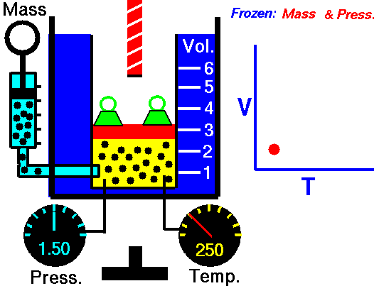
Compressing a gas increases its temperature. Expanding a gas decreases its temperature.

Slide 9
The Effect of Heating or Cooling a Gas Heating → increases KE → increases # of collisions → increases pressure Cooling → decreases KE → decreases # of collisions → decreases pressure -Kelvin temperature and pressure are directly related. -If you double the Kelvin temp → double pressure

Slide 10
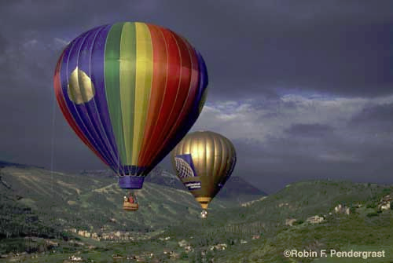
The Gas Laws

Slide 11
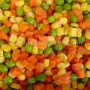
1. Boyle’s Law for Pressure-Volume Changes -for a given mass of gas at constant temperature, the volume of the gas varies inversely with pressure. P₁ V₁ = P₂ V₂ or
“We Boyle Peas and Vegetables”

Slide 12
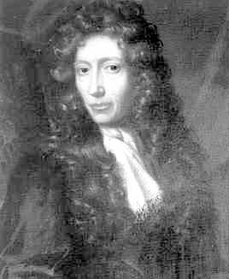
Example: A gas is collected in a 242 mL container. The pressure of the gas in the container is measured and determined to be 87.6 kPa. What is the volume of this gas at 101.3 kPa? Assume the temperature is constant.
P₁ = 87.6
P₂ = 101.3 kPa
V₁ = 242 mL
V₂ = ?
P₁ V₁ = P₂ V₂
(87.6 kPa)(242 mL) = (101.3kPa)V₂
V₂ = 209 mL

Slide 13
2. Charles’ Law for Temperature-Volume Changes The volume of a fixed mass of gas is directly proportional to its Kelvin temperature if the pressure is kept constant. Temperature must be in Kelvin!!!! V₁ = V₂ or V₁ = T₁ T₁ T₂ V₂ T₂
“Charlie Brown’s Christmas is on TV”

Slide 14
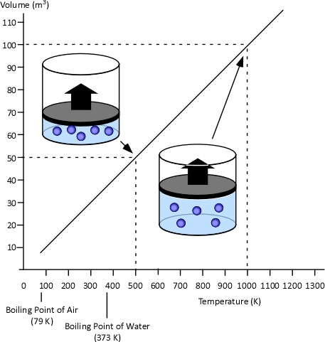
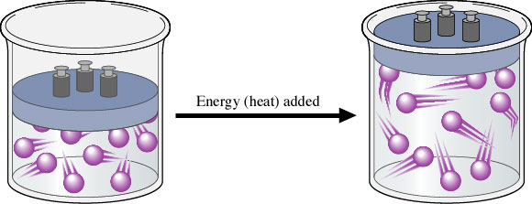

Slide 15
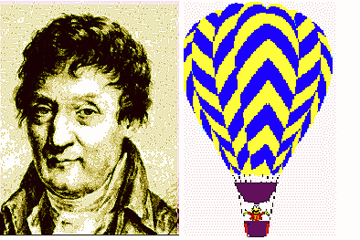
Example: A sample of gas at 15ºC and 1 atm has a volume of 2.58 L. What volume will this gas occupy at 38ºC and 1 atm?
T₁ = 15ºC + 273 =288K V₁ = V₂
T₂ = 38ºC + 273 = 311K T₁ T₂
V₁ = 2.58 L
V₂ = ?
2.58L = V₂
288K 311K
V₂ = 2.79L

Slide 16
3. Gay-Lussac’s Law for Temperature-Pressure Changes The pressure of a gas is directly proportional to the Kelvin temperature if the volume is kept constant. P₁ = P₂ or P₁ = T₁ T₁ T₂ P₂ T₂ Temperature must be in Kelvin!
GayLe drives a PT Cruiser!

Slide 17
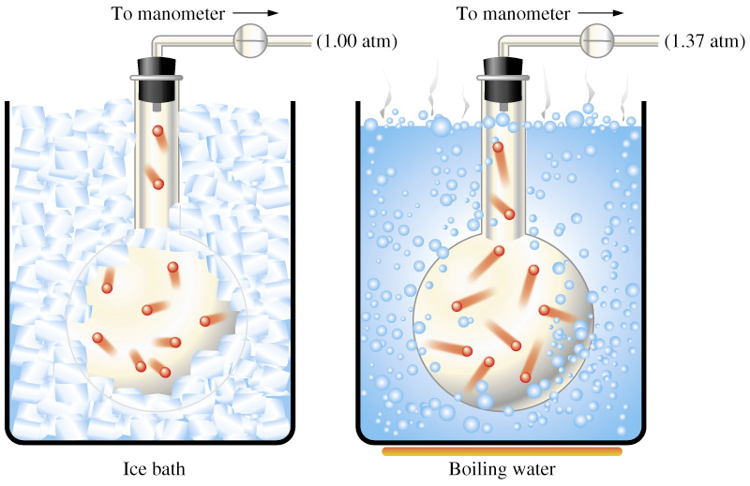

Slide 18
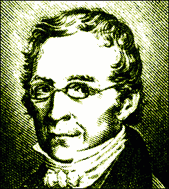
Example: A 2.00 L flask contains helium gas at a pressure of 685 torr and a temperature of 0ºC. What would be the pressure in a flask if the temperature is increased to 150.ºC?
P₁ = 685 torr P₂ =?
T₁ = 0ºC + 273 = 273K
T₂ = 150.ºC + 273 = 423K
P₁ = P₂ 685 torr = P₂
T₁ T₂ 273K 423K
P₂ = 1060 torr

Slide 19
Bellwork Wednesday, 1/5
Write the following statements. We will complete them together.
When the pressure of a gas goes up, the volume…
This means it is a(n) __________________ relationship.
When the temperature of a gas goes up, the volume…
This means it is a(n) __________________ relationship.
When the temperature of a gas goes up, the pressure…
This means it is a(n) __________________ relationship.

Slide 20
Homework Check 1/5
In the candy Pop Rocks ™, CO₂ at a pressure of 45 atm is pumped into the candy as it hardens to make hundreds of tiny bubbles. If you were to eat 15g of Pop Rocks ™ that contained 0.5 mL of CO₂ what would be the volume of CO₂ in your mouth as they all popped? (hint: assume your mouth is at standard pressure)
In the Wizard of Oz, Dorothy tried to get home using a hot air balloon. If Dorothy wanted the balloon to rise, she needed to increase / decreases (circle one) the temperature of the gas? Explain your reasoning in the space below.
A can of whipped topping contains N₂ as propellant under 2400 mmHg pressure. When you take it out of a 3.0°C refrigerator and let it heat up to room temperature (25°C) what would the pressure be on the can? When would the whipped topping shoot out of the can faster; when it is cold or when it is warm?

Slide 21
The Combined Gas Law P₁V₁ = P₂V₂ T₁ T₂ “Peas and Vegetables on the Table” By canceling out terms remaining constant, we can derive Boyle’s, Charles’, and Gay-Lussac’s laws.
P₁V₁ = P₂V₂ T₁ T₂

Slide 22
Ex. If a helium-filled balloon has a volume of 3.40 L at 25.0ºC and 120.0 kPa, what is its volume at STP?
V₁ = 3.40L V₂ = ?
P₁ = 120.0 kPa P₂ = 1 atm = 101.3 kPa
T₁ = 25.0ºC + 273 = 298K
T₂ = 0ºC + 273 = 273K
P₁V₁ = P₂V₂ (120.0 kPa)(3.40L) = (101.3 kPa)V₂
T₁ T₂ 298K 273K
V₂ = 3.69L

Slide 23
A flask contains 1.4L of an ideal gas at 50.0ºC and 1.44atm of pressure. If the gas is compressed to 0.7L and the temperature is raised to 100.0ºC what will be the new pressure in the container?
V₁ = 1.4 L V₂ = 0.7 L
P₁ = 1.44 atm P₂ = ?
T₁ = 50.0ºC + 273 = 323K
T₂ = 100.0ºC + 273 = 373K
P₁V₁ = P₂V₂ (1.44 atm)(1.4L) = (P₂)(0.7 L)
T₁ T₂ 323K 373K
P₂ = 3.3 atm or 3 atm

Slide 24
Ideal gas- follows the gas laws at all conditions of temperature and pressure. - Ideal gases don’t exist ☹ Real gases can be liquefied and sometimes solidified; ideal gases can not.
Real vs. Ideal Gases

Slide 25
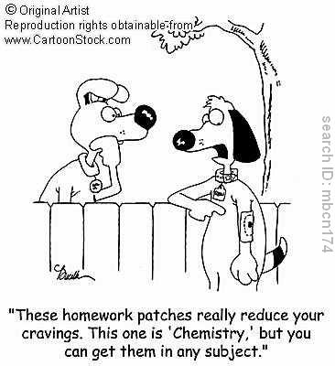
*Gases behave most ideally at high temperature and low pressure. (Just like students in the summer!!!!!!)

Slide 26
The Ideal Gas Law -allows us to include amount of gas (moles) in our calculations. PV = nRT “Puv Nert” P = pressure in atm V = volume in L n = # of moles R = ideal gas constant = 0.0821 (L.atm)/(mol.K) T = temperature in Kelvin

Slide 27
Ex. A 5.0 L flask contains 0.60 g O₂ at a temperature of 22ºC. What is the pressure (in atm) inside the flask?
P=? V= 5.0L R = 0.0821 (L.atm/mol.K)
T = 22°C +273= 295K
n = 0.60g O₂ 1 mol O₂ = 0.01875 mol
32.0g O₂
PV = nRT
P(5.0L) = (0.01875mol)(0.0821Latm/molK)(295K)
P = 0.091 atm

Slide 28
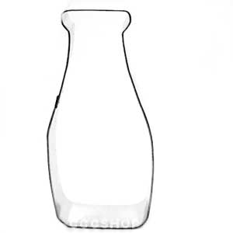
Bellwork Thursday, January 6th
Egg demo.
Draw a picture of two bottles as shown below and be ready to watch the egg demo.
Before
After

Slide 29
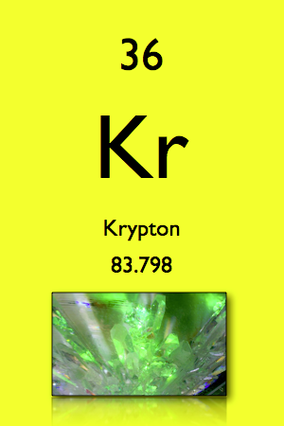
Ex. How many grams of krypton are present in a 600. mL container at 1010ºC in which the pressure of krypton is 10.0 atm?
P = 10.0 atm V= 600.mL = 0.600 L
n = ? R = 0.0821 (L.atm)/(mol.K)
T = 1010ºC + 273 = 1283K
PV = nRT
(10.0atm)(0.600L)= n(0.0821 L.atm)/(mol.K)(1283K)
n = 0.05696 mol Kr
0.05696mol Kr 83.8g Kr = 4.77g Kr
1 mol Kr

Slide 30
How many atoms is this?
0.05696 mol Kr 6.02 x 10²³ atoms Kr
1 mol Kr
= 3.43 x 10²² atoms Kr

Slide 31
Gas Molecules: Mixtures and Movements

Slide 32
Avogadro’s Hypothesis (1811) Equal volume of gases at the same temperature and pressure contain equal numbers of particles.
At STP, 1 mol (6.02 x 10²³ particles of gas) = 22.4L

Slide 33
Dalton’s Law of Partial Pressure -At constant volume and temperature, the total pressure exerted by a mixture of gases is equal to the sum of the partial pressures. P_{total} = P₁ + P₂ + P ₃ …

Slide 34
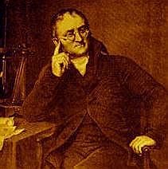
Example: Determine the total pressure of a gas mixture that contains nitrogen and oxygen if the partial pressure of the nitrogen is 725 mm Hg and the partial pressure of the oxygen is 426 mm Hg.
P₁ + P₂ = P_{total}
725 mm Hg + 426 mm Hg
= 1151 mm Hg

Slide 35
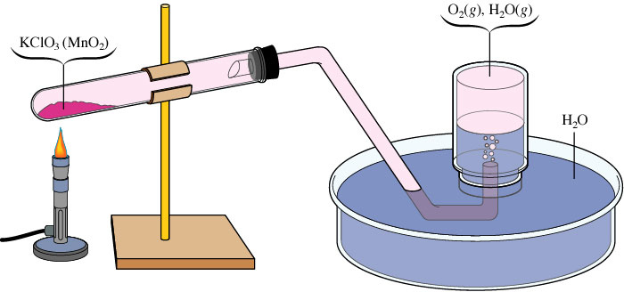
Gases are often collected by water displacement. The total of the gas pressure plus the water vapor pressure is equal to the atmospheric pressure. When we work a problem like this we must always look up and subtract the water vapor pressure to get the gas pressure.

Slide 36
Example: A sample of N₂ gas is collected by the downward displacement of water from an inverted bottle. What is the partial pressure of the N₂ gas at 20.0ºC, if the atmospheric pressure is 752 mm Hg? The water vapor pressure is 17.5 mm Hg at 20.0ºC.
P_{H2O} + P_{N2} = P_{total}
17.5 mm Hg + P_{N2} = 752 mm Hg
P_{N2} = 735 mm Hg

Slide 37
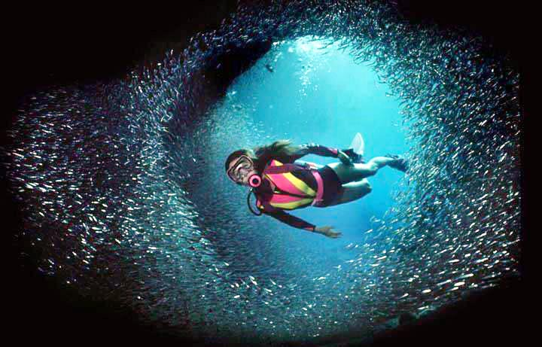
Scuba Science SCUBA = Self Contained Underwater Breathing Apparatus

Slide 38
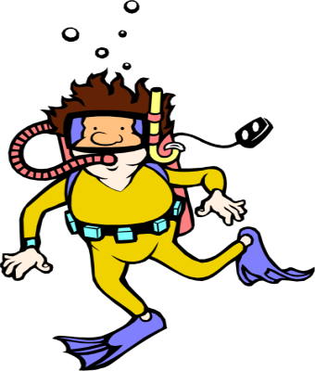
At the surface, pressure is 1 atm. It increases 1 atm for every 10 m underwater. At 30 m, the pressure is 4 atm. At 40m, pressure of 5 atm would not allow you to inflate your lungs to breathe.
Scuba gear increases the pressure in your lungs as you descend, allowing normal breathing.

Slide 39
If a diver ascends without exhaling, the increase in lung volume could cause the lungs to rupture. From 40m (5 atm) to the surface (1 atm), would cause the lungs to increase in volume 5 times!

Slide 40
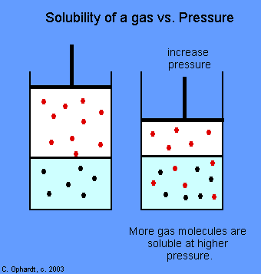
Divers may also experience “the bends”, a condition in which nitrogen dissolves in the blood at high pressures and then comes out as bubbles as the pressure is decreased, causing death.

