Slide 1
Bellwork Thursday
List three things that are sour and three things that are bitter on the top of your chapter 20 worksheet #1.

Slide 2
Chemistry 1 – Unit 14 Chapter 18 PROPERTIES OF ACIDS AND BASES

Slide 3
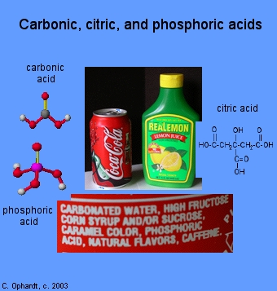
Acids
taste sour or tart (vinegar, lemons)
aqueous solutions of acids are electrolytes
cause indicators to change colors
many metals react with acids to produce H₂ gas
react with hydroxides to form a salt and water
most formulas begin with a H.
pH < 7, pOH > 7
[H₃O+] > 1.0 x 10⁻⁷, [OH⁻] < 1.0 x 10⁻⁷
produce H₃O⁺ (aka H⁺) in water solutions

Slide 4
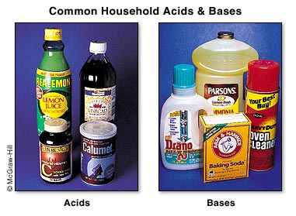
Bases
produce OH⁻ in water solutions
bitter taste (soap, unsweetened chocolate)
feel slippery
react with acids to form a salt and water
cause indicators to change colors
often contain OH⁻
bases are electrolytes in aqueous solution
pH>7, pOH <7
[H₃O⁺] < 1.0 x 10⁻⁷, [OH⁻] > 1.0 x 10⁻⁷

Slide 5
Question
A substance has a formula of HX and has a pH of 4. Is this an acid or a base?

Slide 6
Question
Label the following “A” if they are acids or “B” if they are bases.
___ H₂SO₄
___vinegar
___soap
___Sr(OH)₂
___pH<7
___pH = 11

Slide 7
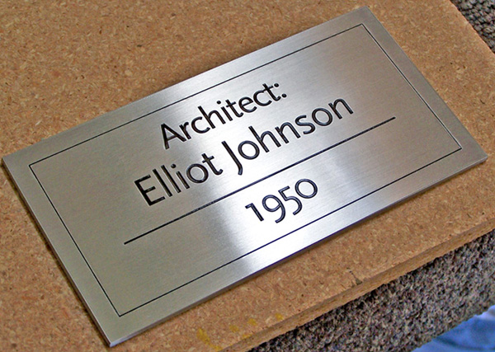
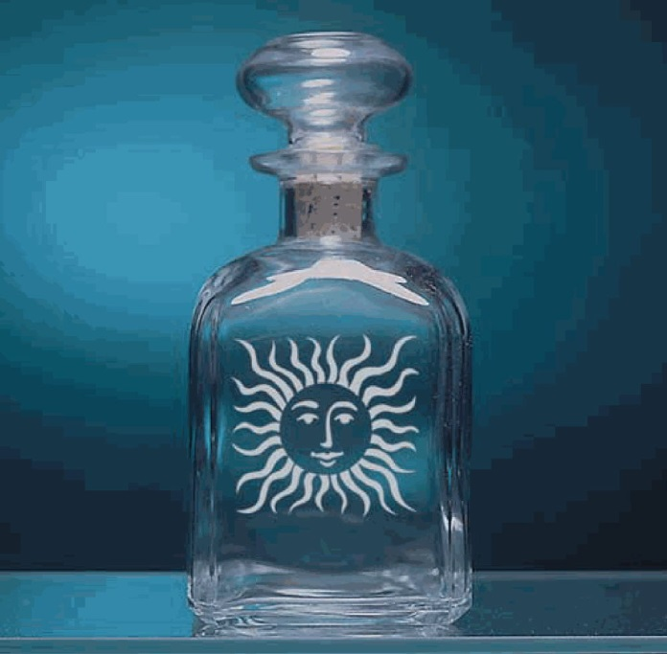
Common uses of acids
HNO₃ or HCl are used for etching metals.
HF is used for etching glass.

Slide 8
hydroxide ion (OH⁻)
formed when a water molecule loses a H⁺
hydronium ion (H₃O⁺)
formed when a water molecule gains a H⁺
H₂O + H⁺ → H₃O⁺
*your text uses H⁺ and H₃O⁺ interchangeably They mean the same thing*

Slide 9
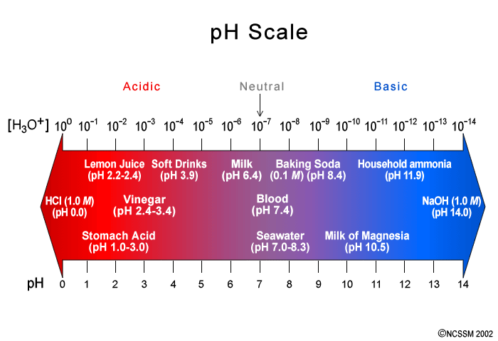
pH Concept:
The pH scale is a measurement of how many hydrogen ions are in a solution.
We can calculate the pH of a solution by using:
pH = - log [H₃O⁺] or - log [H⁺]
This uses a logarithm. A logarithm (log) is the exponent to which 10 must be raised to get the number.
log 10¹ = 1 log 10⁻⁵ = -5
If [H₃O⁺] = 1.0 x 10⁻⁴ then pH = -log 1.0 x 10⁻⁴ so pH = 4.00

Slide 10
Question
What is the formula for pH?

Slide 11
pH Concept
If the pH is known, we can calculate the [H₃O⁺] by using
[H₃O⁺] = antilog (-pH)

Slide 12
Let’s Practice! Grab a calculator. ☺
pH | [H₃O⁺] | [H₃O⁺] | pH
3.44 |  | 1.39 x 10⁻³
11.92 |  | 8.23 x 10⁻⁶
8.334 |  | 9.95 x 10⁻²
3.6 x 10⁻⁴
2.857
1.20 x 10⁻¹²
5.085
4.63 x 10⁻⁹
1.002

Slide 13
Question
What is the pH if:
[H₃O⁺] = 1 x 10⁻⁵ pH = __________
pH = - log [H₃O⁺]
[H₃O⁺] = 1 x 10⁻¹³ pH = ________
pH = - log [H₃O⁺]
[H₃O⁺] = 3 x 10⁻⁷ pH = ________
pH = - log [H₃O⁺]
pH > 7 is basic
pH < 7 is acidic
pH = 7 is neutral
5.0
Acidic
13.0
Basic
6.5
Acidic

Slide 14
Question
How do you know if a substance is an acid or base from the pH?

Slide 15
The pH is not the only part of the pH scale.
The pOH is a measurement of the hydroxide ions in a solution.
It can be calculated using: pOH = -log [OH⁻]
If the pOH is known, you can use the following to find the [OH⁻]: [OH⁻] = antilog (-pOH)

Slide 16
Let’s Practice!
pOH | [OH⁻] | [OH⁻] | pOH
11.9 |  | 9.85 x 10⁻¹¹
3.44 |  | 6.523 x 10⁻⁸
6.57 |  | 8.7 x 10⁻³
1.0 x 10⁻¹²
10.007
3.6 x 10⁻⁴
7.1856
2.7 x 10⁻⁷
2.06

Slide 17
The pH and pOH are related to one another just like the [H₃O⁺] and [OH⁻] are related to one another.
If the pH or pOH of a solution is known, it can be used to find the missing component using: pH + pOH = 14
If the [OH-] or the [H₃O⁺] is known, it can be used to find the missing component using: 1x10⁻¹⁴ = [H₃O⁺][OH⁻].
pH | pOH | [H₃O⁺] | [OH⁻]
9.455 |  | 1.022 x 10⁻⁴
 | 7.11 | 4.93 x 10⁻⁹
 | 0.482 |  | 9.331 x 10⁻⁸
4.545
9.785 x 10⁻¹¹
6.89
2.03 x 10⁻⁶
13.518
1.072 x 10⁻⁷

Slide 18
Question
Convert the following:
pH = 2.44 so
[H₃O⁺] = ______
pH = 0.78 so
[H₃O⁺] = ______
pH = 1.9 so
[H₃O⁺] = ______
pOH = 1.56 so
[OH⁻] = _______
[H₃O⁺] = ______

Slide 19
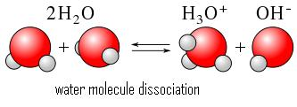
Self-Ionization of Water
Self-ionization of water
2H₂O(l) ↔ H₃O⁺(aq) + OH⁻(aq)
or H₂O ↔ H⁺ + OH⁻
this only occurs to a small extent
In pure water at 25ºC, [H₃O⁺] = [OH⁻] = 1.0 x 10⁻⁷
In any neutral solution at 25ºC, [H₃O⁺] = [OH⁻] = 1.0 x 10⁻⁷
Ion-product constant for water
K_{w} = [H₃O⁺][OH⁻] = 1.0 x 10⁻¹⁴ at 25ºC

Slide 20
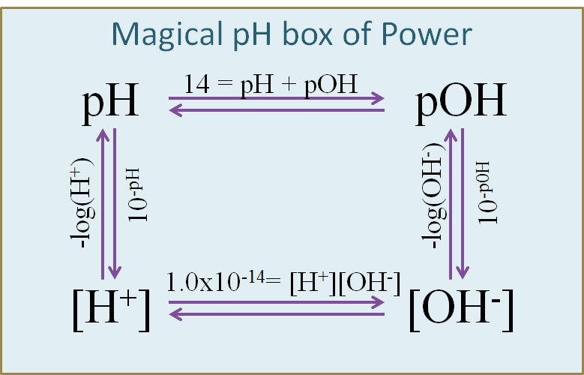
To Summarize!

Slide 21
Question Write if the following are acidic “A” or basic “B”.
[H₃O⁺] = 1 x 10⁻³ ____________
[H₃O⁺] = 1 x 10⁻¹¹ ____________
[OH⁻] = 1 x 10⁻⁴ ___________
[OH⁻] = 1 x 10⁻¹³ __________
Acidic
Basic
Basic
Acidic

Slide 22
Household Acids and Bases Lab Slide
You will use the following formulas to complete your lab work today.
If you have… | And you want… | Use…
pH | pOH | pH+pOH = 14
pH | [H⁺] | [H⁺] = antilog -pH
pOH | [OH⁻] | [OH⁻] = antilog -pOH

Slide 23
Bellwork Monday
Kimmie has an acid solution with a pH of 2.445. Find the following:
[H⁺] ____________________
[OH⁻] ___________________
pOH ____________________
What does the word “electrolyte” mean?

Slide 24
pH 2.445
pOH
[H+]
[OH-]

Slide 25
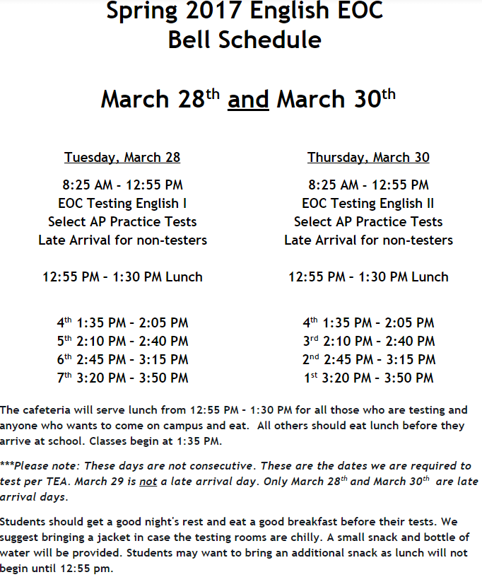

Slide 26
18.2 Indicators p 638
Indicators are substances that change color in solutions of different pH.
Indicators are usually weak acids.
They are one color in their acid form and a different color in their base form.
HIn ↔ H⁺ + In⁻
Help determine approximate pH

Slide 27
Question
Why would a scientist use an indicator?

Slide 28
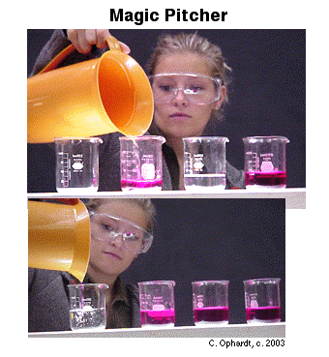
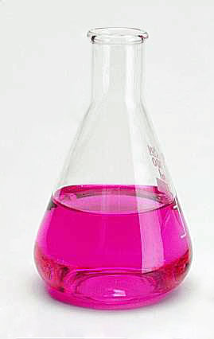
Indicators
phenolphthalein
colorless in acid
pink in base
changes at pH 8.0 -10.0

Slide 29
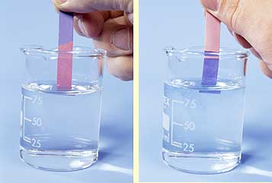
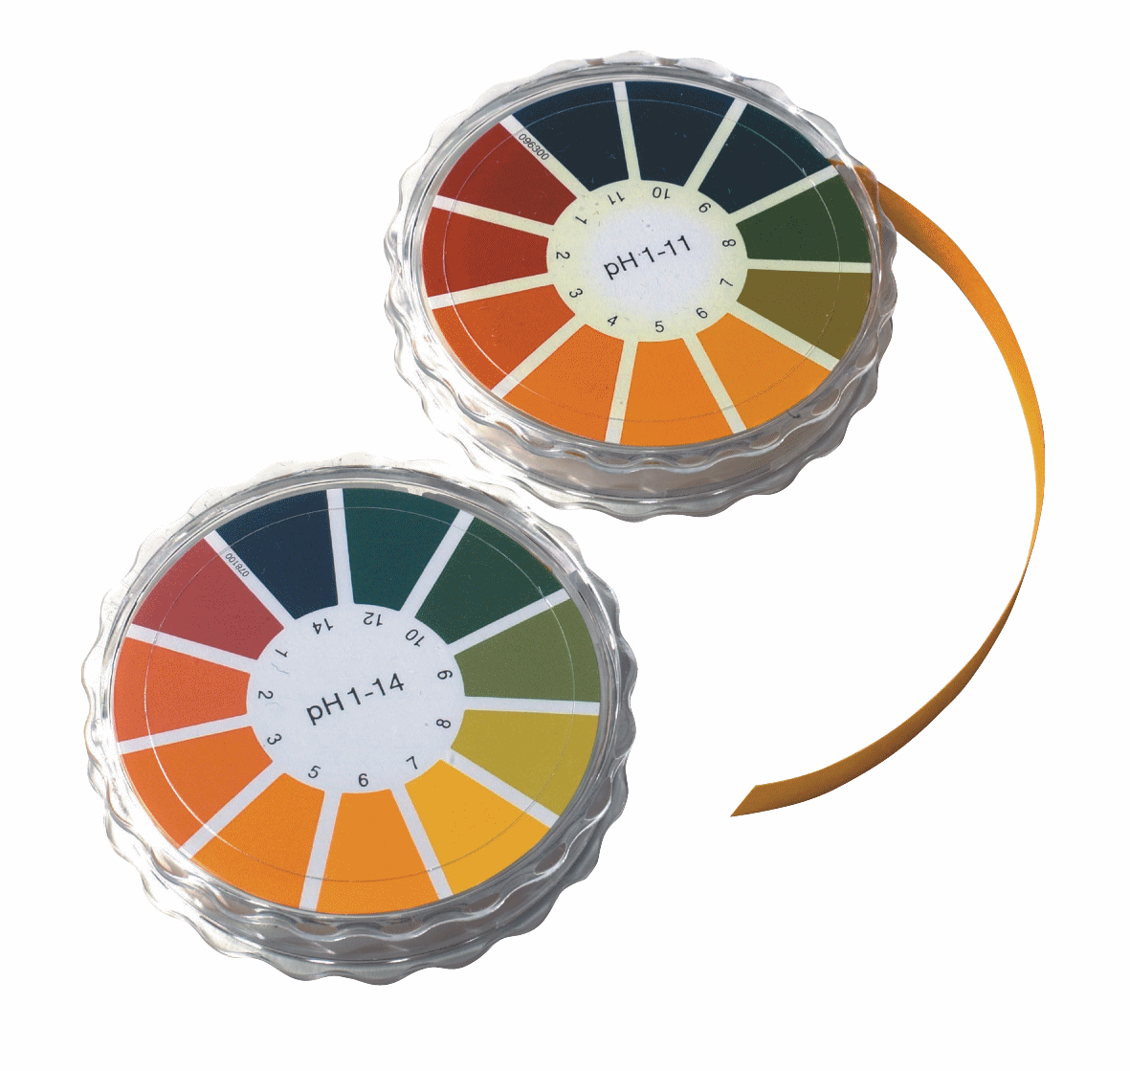
Indicators cont.
litmus
blue litmus turns red in acid
red turns blue in base
universal indicator
mixture of indicators
changes into different colors at each pH (rainbow colors)

Slide 30
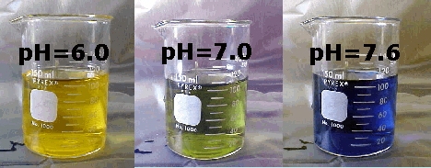
Indicators
bromothymol blue
blue in base
yellow in acid
green in neutral

Slide 31
Question
A solution has a hydroxide ion concentration of 1.5x10⁻³M. What is the [OH⁻], the [H₃O⁺], and what indicator(s) would be useful with this solution?

Slide 32
18.3 Types of Acids
Acids can be defined by the number of hydrogen ions they produce when ionizing in a solution.
Monoprotic acid- contains one ionizable hydrogen.
Ex. HCl, HNO₃
Diprotic acid- contains two ionizable hydrogens.
Ex. H₂SO₄
Triprotic acid- contains three ionizable hydrogens.
Ex. H₃PO₄

Slide 33
Question
Label these acids as mono, di or tri protic.
_____ HBr
_____ HI
_____ H₂CO₃

Slide 34
Bellwork Friday
Charlie is testing a colorless solution to see if it is an acid or a base. He uses three indicators on three samples of the solution. His results are…
Phenolphthalein = colorless
Bromothymol blue = yellow
Litmus = red
Was Charlie’s substance an acid or a base?

Slide 35
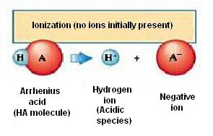
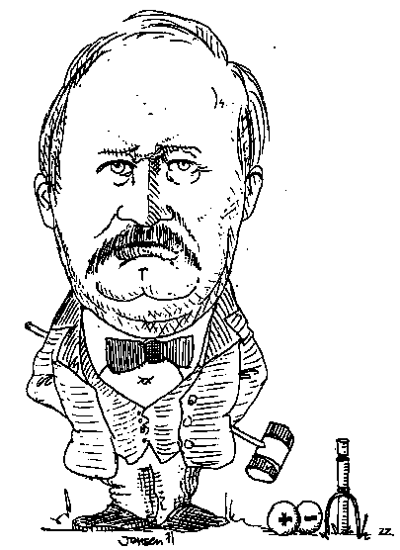
18.1 3 Theories or Definitions of Acids and Bases
Arrhenius
Acid: compound containing hydrogen that ionizes to yield hydrogen ions in solution
Base: compound that ionizes to yield hydroxide, OH⁻ ions in solution

Slide 36
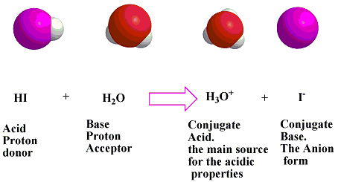
BrØnsted-Lowry
Acid: hydrogen-ion donor (proton donor)
Base: hydrogen-ion acceptor (proton acceptor)
NH₃ + H₂O ↔ NH₄⁺ + OH⁻
base acid

Slide 37
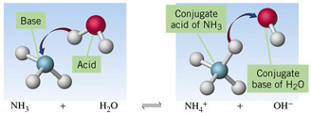
conjugate acid- particle formed when a base gains a hydrogen ion
conjugate base- particle formed when an acid loses a hydrogen ion

Slide 38
HCl + H₂O → H₃O⁺ + Cl⁻
H₂O + C₂H₃O₂- ↔ HC₂H₃O₂ + OH⁻
H₂O + H₂O ↔ H₃O⁺ + OH⁻
amphoteric- substance that can act as both an acid and a base. Ex. H₂O
Acid
Base
CA
CB
Acid
Base
CA
CB
Base
Acid
CA
CB

Slide 39
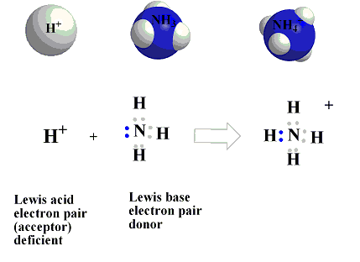
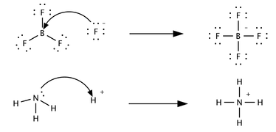
Lewis Acids and Bases:
acid: electron pair acceptor
base: electron pair donor
Example:
H⁺ + H₂O → H₃O⁺
AlCl₃ + Cl⁻ → AlCl₄⁻
Acid
Base
Acid
Base

Slide 40
KNOW THESE!!!
Common acids Common bases
HCl NaOH
HNO₃ KOH
H₂SO₄ Ca(OH)₂
H₃PO₄ Mg(OH)₂
HC₂H₃O₂ NH₃
H₂CO₃

Slide 41
Strengths of Acids and Bases
Concentrated and dilute are different from strong and weak.
Strong acids
are completely ionized in aqueous solution
Ex. HCl, HNO₃, H₂SO₄ (Know these!)
Weak acids
ionize only slightly in aqueous solution
Ex. H₃PO₄, H₂CO₃, HC₂H₃O₂
HC₂H₃O₂(aq) ↔ H⁺ (aq) + C₂H₃O₂⁻(aq)
~99% ~1% ~1%
K_{a} = 1.8 x 10⁻⁵

Slide 42
Strong bases
dissociate completely into metal ions and hydroxide ions in aqueous solution
Ex. NaOH, KOH, Ca(OH)₂
Weak bases
do not dissociate completely in aqueous solution
Ex. NH₃, CH₃NH₂
NH₃ (aq) + H₂O(l) ↔ NH₄⁺ (aq)+ OH⁻(aq)
~99% ~ 1% ~1%
K_{b} = 1.8 x 10⁻⁵

Slide 43
Question
What is the difference between strong acids and bases and weak acids and bases?

Slide 44
Weak acid and weak base equilibria
Equilibrium constants for the dissociation of weak acids are called K_{a} values.
for a generic weak acid:
HA ↔ H⁺ + A⁻
K_{a} = [H⁺][A⁻]
[HA]

Slide 45
The larger the K_{a}, the stronger the acid. We don’t have K_{a} values for strong acids because there is no [HA] left. (K_{a} table p. 602)
Each H in a diprotic or triprotic acid has a separate K_{a} value.
HCN↔ H⁺ + CN⁻
K_{a} = [H⁺][CN⁻]
[HCN]

Slide 46
Equilibrium constants for weak bases are called K_{b} values.
NH₃(aq) + H₂O(l) ↔ NH₄⁺(aq) + OH⁻(aq)
K_{b} = [NH₄⁺][OH⁻]
[NH₃]
The larger the K_{b} value, the stronger the base.

Slide 47
Question
What do K_{a} and K_{b} values tell you?

Slide 48
Bellwork Monday
Name the acid, base, conjugate acid and conjugate bases below.
H₂SO₄ + 2NaOH → Na₂SO₄ + 2H₂O
6KOH + 2H₃PO₄ → 2K₃PO₄ + 6H₂O
HC₂H₃O₂ + NH₃ → NH₄⁺ + C₂H₃O₂⁻

Slide 49
Working Ka and Kb problems
1st: Write the equation
2nd: Set up a reaction diagram (RICE diagram)
3rd: Set up K_{a} or K_{b} expression
4th: Substitute values into K_{a} or K_{b} expression
5th: Solve K_{a} or K_{b} expression for X.
6th: Calculate pH from H⁺ or OH⁻ concentration.
R = reaction
I = initial
C = change
E = equilibrium

Slide 50
Example:
Calculate the pH of a 0.10 M solution of acetic acid. The K_{a} for acetic acid is 1.8 x 10⁻⁵.
R HC₂H₃O₂ ↔ H⁺ + C₂H₃O₂⁻
I
C
E
.1
0
0
-x
+x
+x
.1- x
x
x
[H⁺]
[C₂H₃O₂⁻]
[x]
[x]
K_{a} =
=
=
1.8 x 10⁻⁵
[HC₂H₃O₂]
[0.1-x]

Slide 51
[x]
[x]
=
1.8 x 10⁻⁵
[.1-x]
pH = -log [H⁺]
pH = -log(1.3 x 10⁻³)
x²
=
1.8 x 10⁻⁵
.1-x
pH= 2.87
x²
=
1.8 x 10⁻⁵
.1
x²
=
1.8 x 10⁻⁶
x
= [H+]
=
1.3 x 10⁻³

Slide 52
Example:
Calculate the pH of a 0.25 M solution of HCN. The K_{a} for HCN is 6.2 x 10⁻¹⁰.
R HCN ↔ H⁺ + CN⁻
I
C
E
.25
0
0
-x
+x
+x
.25 - x
x
x
[H⁺][CN⁻]
[HCN]
[x][x]
.25 – x
Ka = 6.2 x 10⁻¹⁰ =
=

Slide 53
K_{a} = 6.2 x 10⁻¹⁰ = [H⁺][CN⁻] = [x][x]
[HCN] .25 – x
X²
.25
= 6.2 x 10⁻¹⁰
X² =
1.55 x 10⁻¹⁰
x = 1.24 x 10⁻⁵
= [H+]
pH = -log [H⁺]
pH = -log(1.24 x 10⁻⁵)
pH= 4.9

Slide 54
Calculate the pH of a 0.15 M solution of ammonia. The K_{b} of ammonia is 1.8 x 10⁻⁵.
R NH₃ + H₂O (l) ↔ NH₄⁺ + OH⁻
I
C
E
.15
0
0
-x
+x
+x
.15 –x
x
x
Kb = [NH₄⁺] [OH⁻]
[NH₃]
[x][x]
.15 – x
=

Slide 55
K_{b} = [NH₄⁺] [OH⁻] = [x][x]
[NH₃] .15 – x
X² = 1.8 x 10⁻⁵
.15
X² = 2.7 x 10⁻⁶
X = 0.0016
pOH = -log (OH⁻)
pOH = -log (0.0016)
pOH = 2.78
14 – 2.78 = pH
= [OH⁻]
pH = 11.2

Slide 56
Calculate the OH⁻ of a 1.0 M solution of methylamine (K_{b} = 4.38 x 10⁻⁴).
R CH₃NH₂ + H₂O ↔ CH₃NH₃⁺ + OH⁻
I
C
E
1.0
0
0
-x
+x
+x
1.0 - x
x
x
Kb = [CH₃NH₃⁺] [OH⁻] = [x][x]
[CH₃NH₂] 1.0 – x

Slide 57
K_{b} = [x][x] = 4.38 x 10⁻⁴
1-x
x² = 4.38 x 10⁻⁴
1
X² = 4.38 x 10⁻⁴
[OH⁻] = 0.0209
What is the pOH?
pOH = -log (OH⁻)
pOH = -log (0.0209)
pOH = 1.68
What is the pH?
pH + pOH = 14
pH = 12.32
pH + 1.68 = 14

Slide 58
Bellwork
Calculate the pH of a 2.24 M solution of ammonia. The K_{b} of ammonia is 1.8 x 10⁻⁵.

Slide 59
Bellwork
Daniel has a solution of phosphoric acid that has a [H⁺] of 2.50 x 10⁻⁴M.
What is the pH, pOH and [OH-] of this solution?
What is the K_{a} expression for this acid?

Slide 61
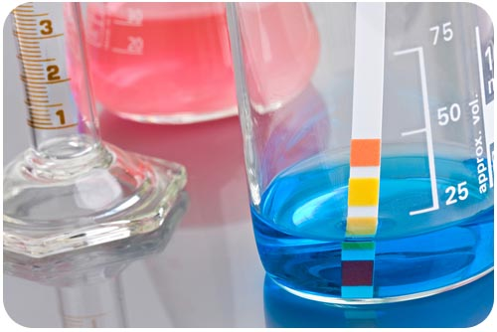
In-Class Practice
Due at the end of the period for +10
Due tomorrow for full credit

Slide 62
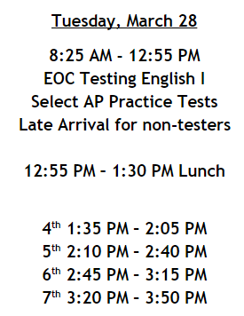
No bell work: Write “STAR TESTING”
Acid Base Lab and WS #1 Of HW Packet will be due tomorrow!
Also, the rate law major lab (test grade) was due yesterday FYI

Slide 63
No bell work: Write “STAR TESTING”
Mole Stations are Due TODAY at the end of class
FYI: The Penny major lab (test grade) was due yesterday

