Slide 1
Electrochemistry
The interconversions of chemical and electrical energy that involve the transfer of electrons.
This process occurs in a device called an electrochemical cell.

Slide 2
The Activity Series and Redox
Activity Series
Lithium
Potassium
Calcium
Sodium
Magnesium
Aluminum
Zinc
Chromium
Iron
Cadmium
Nickel
Tin
Lead
Hydrogen
Copper
Mercury
Silver
Platinum
Gold
Used to determine reactivity in single replacement redox reactions
Electrons are lost by the more active metals and gained by the less active metals
The higher a metal is on the activity series, the easier it is oxidized
The simplified order from most reactive to least reactive:
group I&II metals plus Al
the transition metals
H
"jewelry metals” (Cu, Hg, Ag, Au)

Slide 3
Let’s Practice!
Activity Series
Lithium
Potassium
Calcium
Sodium
Magnesium
Aluminum
Zinc
Chromium
Iron
Cadmium
Nickel
Tin
Lead
Hydrogen
Copper
Mercury
Silver
Platinum
Gold
Circle the more active metal!
Fe / Cu
Ca / Ag
Au / H
H / Na

Slide 4
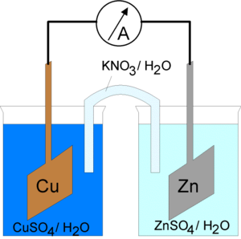
Batteries
Electrochemical cells that convert chemical energy into electrical energy are called voltaic cells.
The energy is produced by spontaneous redox reactions.
Voltaic cells can be separated into two half cells.
A half cell consists of a metal rod or strip immersed in a solution of its ions.

Slide 5
Batteries
We write half reactions to show what happens in each part of the cell.
Example Write the half reactions that occur in the Fe²⁺/Ni²⁺ cell.
Oxidation Fe → Fe²⁺ + 2e⁻
Reduction Ni²⁺ + 2e⁻ → Ni

Slide 6
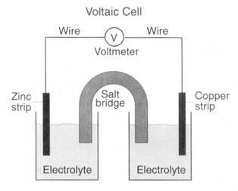
Diagram of voltaic cell for the reaction of zinc and copper
Oxidized: Zn → Zn²⁺ + 2e⁻
Reduced: Cu²⁺ + 2e⁻ → Cu
Direction of electron flow
From anode to cathode
anode
cathode
Solution of
Solution of
Zinc ions
Copper ions

Slide 7
EXAMPLE:
Predict what will happen if an iron nail is dipped into a solution of CuSO₄. Write the balanced equation and the two half-reactions (reduction and oxidation reactions).
Iron is above copper on the activity series, so iron is oxidized:
Fe(s) + CuSO₄(aq) → FeSO₄(aq) + Cu(s)
Oxidation: Fe → Fe²⁺ + 2e⁻
Reduction: Cu²⁺ + 2e⁻ → Cu

Slide 8
Half-Cells
The half cells are connected by a salt bridge
A tube containing a solution of ions.
Ions pass through the salt bridge to keep the charges balanced.
Electrons pass through an external wire.
The metal rods in voltaic cells are called electrodes.
Oxidation occurs at the anode and reduction occurs at the cathode. (An Ox and Red Cat)
The direction of electron flow is from the anode to the cathode. (FAT CAT )

Slide 9
Calculating the Charge of a Battery
The potential charge of a battery can be calculated with a set of values from a table of reduction potentials.
To do this, write the oxidation and reduction half reactions.
Look up the cell potentials from the data table.
Flip the sign of the cell potential for oxidation.
Add the potentials together.

Slide 10
Example A common battery is made with nickel and cadmium. What is the cell potential of this battery? (E⁰_{Cd} = -0.40V, E⁰_{Ni} = -0.25V)
Oxidation Cd → Cd²⁺ + 2e⁻ E⁰ = 0.40V
Reduction Ni²⁺ + 2e⁻ → Ni + E⁰ = -0.25V
Total = E⁰ = 0.15V

